Slide 1

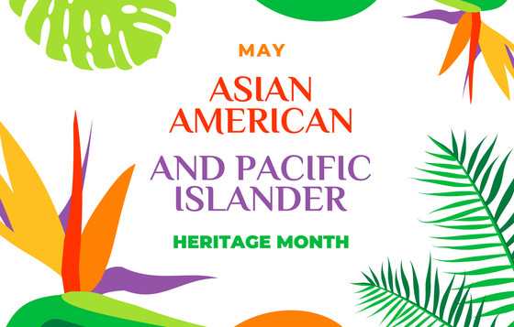
Notes:
May is Asian American and Pacific Islander Heritage Month – AAPI Month.

Slide 2

History of AAPI
1978 - President Jimmy Carter proclaims the first 10 days in May Asian/Pacific American Heritage Week
1992 - Congress passed a bill declaring the month of May Asian American Pacific Islander Heritage Month
Notes:
On October 5, 1978, President Jimmy Carter signed Resolution 1007, proclaiming the first ten days in May as ‘Asian/Pacific American Heritage Week’. In 1992, Congress passed Public Law 102-450, which called for the entire month of May to be recognized as Asian American Pacific Islander Heritage Month.
The month of May was significant and selected for two reasons:
1) To commemorate the arrival of the first known Japanese immigrant to the U.S. on May 7, 1843.
2) To honor the completion of the transcontinental railroad on May 10, 1869 — the building of which up to 20,000 Chinese workers participated in.

Slide 3

AAPI Key Facts & Demographics
There is an estimated 20 million AAPIs in the U.S. representing over 30 countries and ethnic groups that speak over 100 different languages.
AAPIs are the fastest growing population in the United States.
Notes:
There is an estimated 20 million Asian American and Pacific Islanders in the U.S. and they are the fastest-growing population in the United States.
AAPIs represent over 30 countries and ethnic groups that speak over 100 different languages.
Asian Americans are the most rapidly growing segment of the U.S. labor force, with considerable occupational diversity across groups.
Since 2008, there have been more immigrants coming from Asia than from any other region in the world.

Slide 4

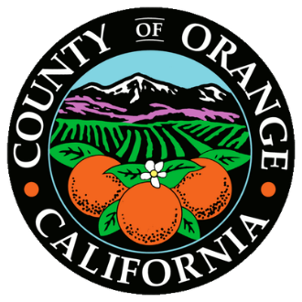
AAPI Facts & Demographics in OC & CA
Orange County has an estimated AAPI population of nearly 600,000
2019 OC Fair Survey results showed 16% of attendees identified as AAPI
Approximately 12% of OCFEC Civil Service Employees identify as AAPI
Notes:
California has the largest Asian American population in the U.S and Orange County has an estimated AAPI population of nearly 600,000.
At the last OC Fair held in 2019, survey results showed that 16% of respondents identified as AAPI…
…and approximately 12% of the OC Fair & Event Center civil service staff identify as AAPI.

Slide 5
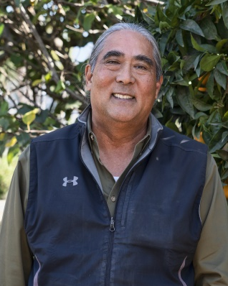
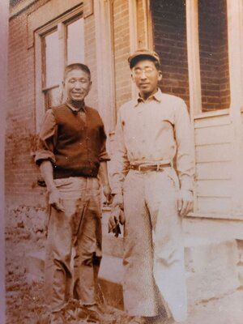
Contributions of AAPIs in Agriculture
A.G. Kawamura: former Secretary of CDFA (2003 – 2010)
Tsurumatsu “T.M.” Asari: first documented Japanese immigrant in Wintersburg, California
Tanaka Farms: family-owned and operated for over 100 years
A.G. Kawamura
Teruo and George Tanaka
Notes:
A.G. Kawamura is a 3rd generation fruit and vegetable grower and shipper from Southern California. He is the former Secretary of the California Department of Food and Agriculture (2003-2010). He has worked in innovative ways to provide fresh produce to local food banks through his non-profit, Solutions For Urban Agriculture.
Tsurumatsu “T.M.” Asari was the first documented Japanese immigrant in Wintersburg, California (Huntington Beach). Asari was already a successful sugar beet and alfalfa farmer and merchant by the time he opened the Asari Goldfish Hatchery and tried his hand at goldfish farming.
Founded by Teruo Tanaka, Tanaka Farms is family owned and operated and has been in existence for over 100 years. Tanaka Farms, currently located in Irvine, “strives to provide quality produce and to educate the community on the values of healthy eating“.

Slide 6
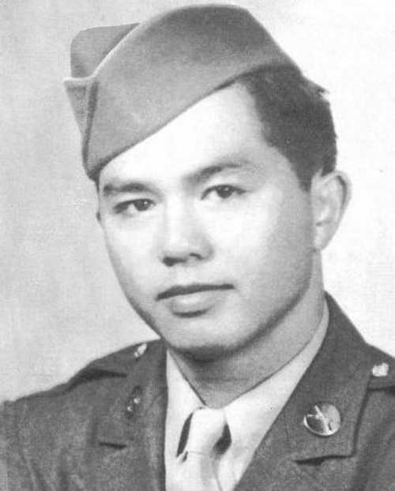
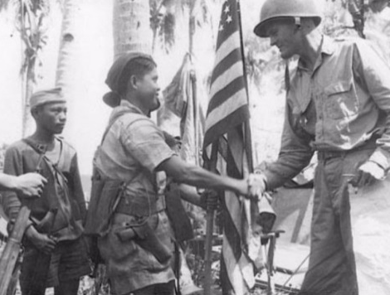
Contributions of AAPIs in World War II
Japanese Americans served in World War II and many of them died for this country, including Kazua Masuda from Orange County.
Filipino soldiers and civilians fought along side American troops in the Philippines, where an estimated one million Filipinos lost their lives.
Kazua Masuda
Notes:
In honor of Heroes Hall, we recognize the many AAPI veterans who have served our country from Orange County.
During World War II, the 442nd Regimental Combat Team, made up entirely of Japanese Americans, was the most highly decorated unit in the history of American warfare for its size and length of service. With more than 18,000 medals and honors awarded to the 14,000 who served, the 442nd is known today as the Purple Heart Battalion.
Kazuo Masuda, an Orange County native, was assigned to 442nd RCT. He was killed during a battle in Italy while providing cover for his comrades to escape. He was awarded the Distinguished Service Cross posthumously for extraordinary heroism. Kazua Masuda Middle School in Fountain Valley was dedicated in his honor in 1975. A plaque with his commendation can be found in the Heroes Hall Walk of Honor.
Filipino soldiers and civilians fought along American troops in the Philippines during WWII. An estimated one million Filipinos lost their lives in the war.

Slide 7
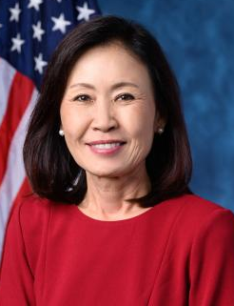
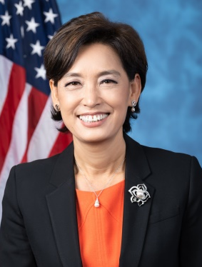
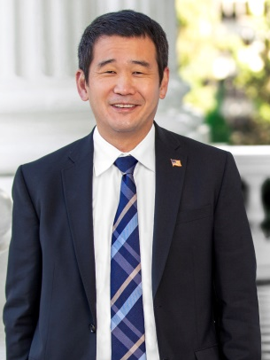
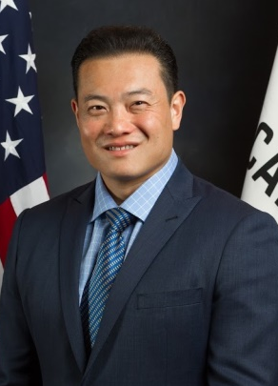
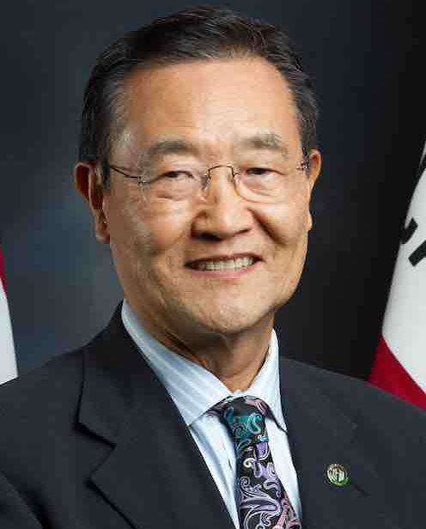
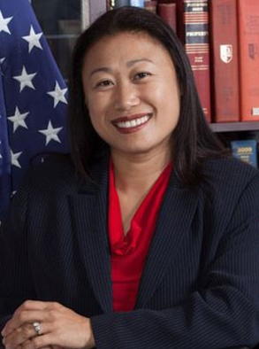
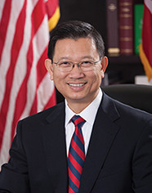
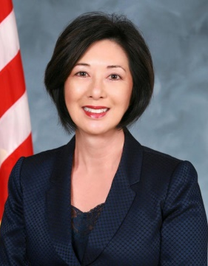
AAPI Political Leaders in Orange County
Michelle Steel, Congresswoman, 48th District
Young Kim, Congresswoman, 39th District
David Min
Senator,
37th District
Philip Chen, Assemblyman, 55th District
Stephen Choi, Assemblyman, 68th District
Janet Nguyen, Assemblywoman, 72nd District
Andrew Do
OC Supervisor,
First District
Lisa Bartlett
OC Supervisor,
Fifth District
Notes:
The AAPI community is well represented in political leadership in Orange County including:
Congresswoman Michelle Steel, 48th District
Congresswoman Young Kim, 39th District
State Senator Dave Min, 37th District
State Assemblyman Philip Chen, 55th District
State Assemblyman Stephen Choi, 68th District
State Assemblywoman Janet Nguyen, 72nd District
OC Supervisor Andrew Do, 1st District
And
OC Supervisor Lisa Bartlett, 5th District

Slide 8
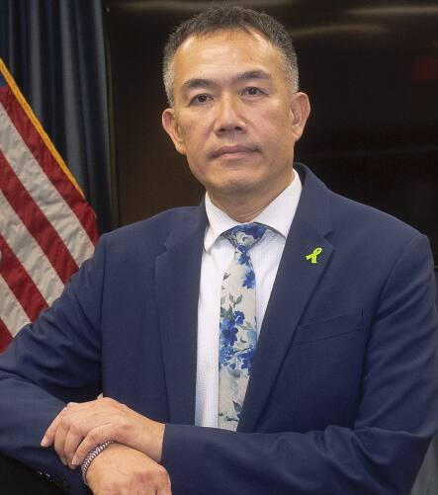
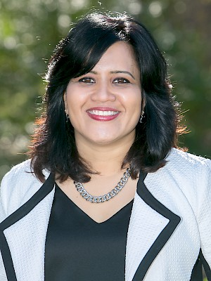
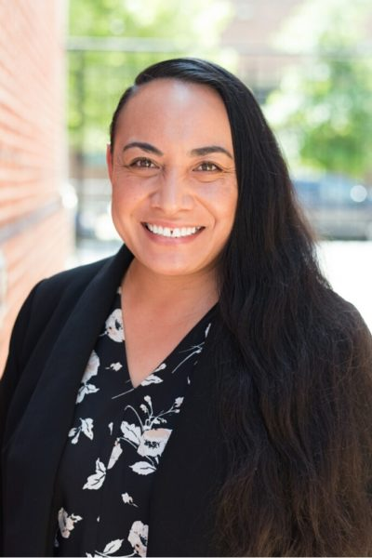
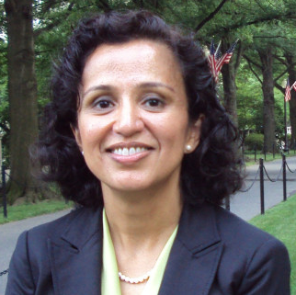
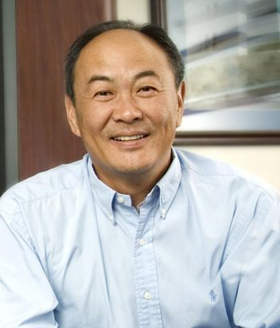
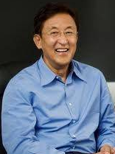
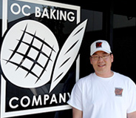
AAPI Leaders in Orange County
Dr. Clayton Chau, MD, PhD
Director of the OC Health Care Agency
Kirti Mutatkar, President and CEO of United Agribusiness League
Manjusha P. Kulkarni, Executive Director,
Asian Pacific Policy and Planning Council
’Alisi Tulua,
Manager, OC Asian and Pacific Islander Community Alliance
Dean Kim,
OC Baking Company
David Sun,
Co-founder, COO
Kingston Technology Co.
John Tu,
Co-founder, President
Kingston Technology Co.
Notes:
Other top AAPI leaders in Orange County include:
Dr. Clayton Chau – Director of the OC Health Care Agency
Kirti Mutatkar – President and CEO of the United Agribusiness League
Manjusha Kilkarni – Executive Director of the Asian Pacific Policy and Planning Council
Alisi Tulua – serves with the OC Asian and Pacific Islander Community Alliance and the National Coalition for Asian Pacific American Community Development
Dean Kim – manager of the OC Baking Company, supplying bread to over 100 restaurants in Orange County.
David Sun and John Tu – co-founders of Kingston Technology Co.

Slide 9

Support AAPI Business in Orange County
Cafés & Restaurants
• Recess Room
• 7 Leaves Cafe
• Cream Pan
• Mix Mix Kitchen
• ADYA @ Anaheim Packing House
• Banh Xeo Boys at Rodeo 39
• Burntzilla & Burnt Crumbs
• Dough & Arrow
• Da Hawaiian Kitchen
• Cream Pan
• Ai Pono Cafe
• Brodard Restaurant
• Green Chilis
Shops & Services
• Eye Wellness Optometry
• Studio 18 Nail Bar
• Venus Spa
• Royale Dry Cleaners
• Mitsuwa Marketplace
• VS Music Studios
• Hiro’s Auto Repair
• Tokyo Central
• Alan He Hair Studio
• Lee Acupucture
• India Spices & Groceries
• Lokelani’s Rhythm of the Islands
Dance Studio
Notes:
Take a look at this small sample of AAPI-owned businesses in Orange County

Slide 10

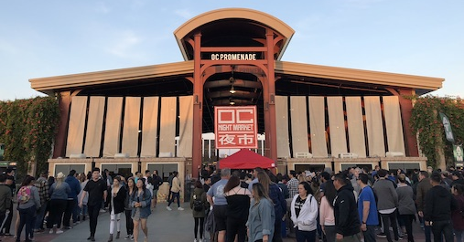

AAPI Events held at OCFEC
Notes:
OC Fair & Event Center is proud to be the host location for these wonderful AAPI cultural festivals and events:
OC Japan Fair
OC Night Market
Tet Festival

Slide 11
How to celebrate AAPI Heritage Month
Read and learn about the history of AAPI communities.
Explore Historical Moments: Visit online museums, events, and exhibits for AAPI communities.
Learn about traditional Asian and Pacific Island music & instruments.
Support AAPI non-profit organizations.
Notes:
You can help celebrate AAPI Heritage Month by reading and learning about the history of AAPI communities, particularly in Orange County.
You can explore historical moments by visiting online museums, attending events and discovering exhibits for AAPI communities.
You also learn about traditional Asian and Pacific Islander music and unique instruments.
And, you can support AAPI non-profit organizations that help those in the Asian American and Pacific Islander communities in Orange County.

