Slide 1

Board of Directors Meeting
April 24, 2025
Good morning.
The meeting will begin just after 9:30 a.m. For members of the public on Zoom – for Public Comment, please use the chat function to communicate to the meeting secretary to indicate which agenda items you would like to speak to.
Please keep your device on mute until called upon to speak.
If using the Zoom dial-in option, use *6 to mute and un-mute your phone.
Please take notice that this public meeting of the 32nd District Agricultural Association, a California state institution, is being recorded using video recording equipment. Please also take notice that the 32nd District Agricultural Association will release video recordings of its public meetings where required under California law.
Please keep your device on mute

Slide 2

The Mission of OCFEC is… Enhancing equitable community access to agriculture, entertainment, cultural and educational experiences

Slide 3
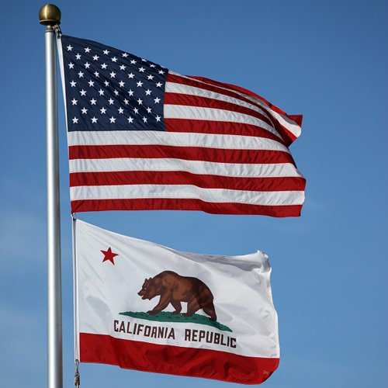
3. Pledge of Allegiance

Slide 4
4. Roll Call
Board of Directors
Chair Nick Kovacevich
Vice Chair Barbara Bagneris
Director Newton Pham
Director Doug La Belle
Director Natalie Rubalcava-Garcia
Director Robert Ruiz
Director Tanya Bilezikjian
Director Dimetria Jackson

Slide 5
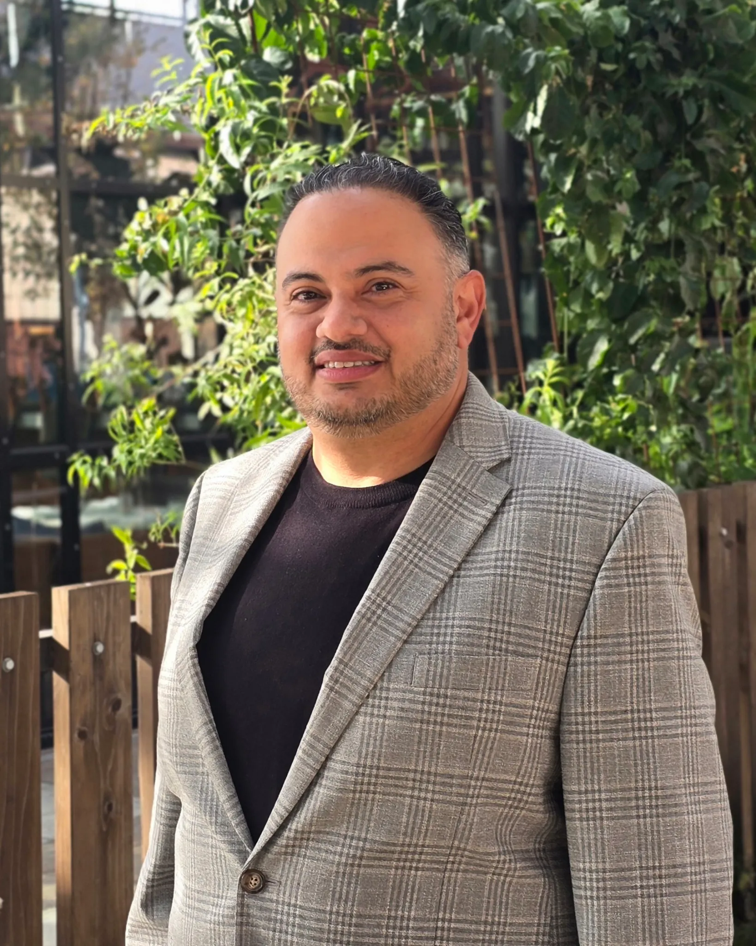

10A. Presentation of Arab American Heritage Month Proclamation by Community Affairs Committee
INFORMATION ITEM:
In recognition of Arab American Heritage Month, the Committee will present a proclamation to Rashad Al-Dabbagh, founder and executive director of the Arab American Civic Council.
Mr. Al-Dabbagh will be honored for his leadership in advocating for the Arab American community and inspiring community engagement, ensuring voices of Arab Americans are heard and represented.

Slide 6
5. Minutes
Board meeting held March 21, 2025
Action item
Board meeting held March 27, 2025
Action Item
Board meeting held April 9, 2025
Action Item

Slide 7
6. Consent Calendar
All matters listed under Consent Calendar are operational matters about which the Board has governing policies, implementation of which is delegated to the CEO. They will be enacted in one motion by category in the order listed below. There will be no discussion of these items prior to the time the Board of Directors votes on the motion, unless members of the board, staff or public request specific items to be discussed separately and/or removed from this section.
Any member of the public who wishes to discuss Consent Calendar items should notify the Chair of the Board, at the time requested and be recognized by invitation of the Chair to address the Board.

Slide 8
7. Closed Session
A. Pending Litigation – The Board will meet in closed session to consult with legal counsel regarding the following pending litigation. [Gov. Code section 11126(e).]
To confer with and receive advice from legal counsel regarding potential litigation involving the 32nd District Agricultural Association. Based on existing facts and circumstances, the Board of Directors will decide whether to initiate litigation. (Govt. Code, § 11126, subd. (e).)
To confer with and receive advice from legal counsel regarding potential litigation involving the 32nd District Agricultural Association. Based on existing facts and circumstances, there is significant exposure to litigation against the 32nd District Agricultural Association. (Govt. Code, § 11126, subd. (e).)
To confer with counsel, discuss, and consider the following pending litigation to which the 32nd DAA is a party. Changing Strides, et al., v. 32nd District Agricultural Association, et. al., Orange County Superior Court, Case No. 30-2024-01421750-CU-WM-WCJ
To confer with counsel, discuss, and consider the following pending litigation to which the 32nd DAA is a party. Changing Strides, et al., v. 32nd District Agricultural Association, et. al., Orange County Superior Court, Case No. 30-2024-01423147-CU-OR-CJC
B. Personnel: The Board will meet in closed session to consider the appointment, employment, and/or evaluation of performance of the General Manager / CEO as authorized by Government Code, § 11126, subdivision (a).

Slide 9
8. Matters of Public Comment
Public comment is allowed on issues NOT on the current agenda. However, no debate by the Board shall be permitted on such public comments, and no action will be taken on such public comment items at this time, as law requires formal public notice prior to any action on an agenda item. Speakers are requested to sign in prior to the start of the meeting and are limited to three minutes.
Comments will be accepted on all other agenda items at the time each item is listed on the agenda. Speakers wishing to address the Board on items on the agenda are requested to sign in prior to the start of the meeting and identify the agenda item(s) on which you desire to address the Board. Speakers are limited to three minutes.

Slide 10
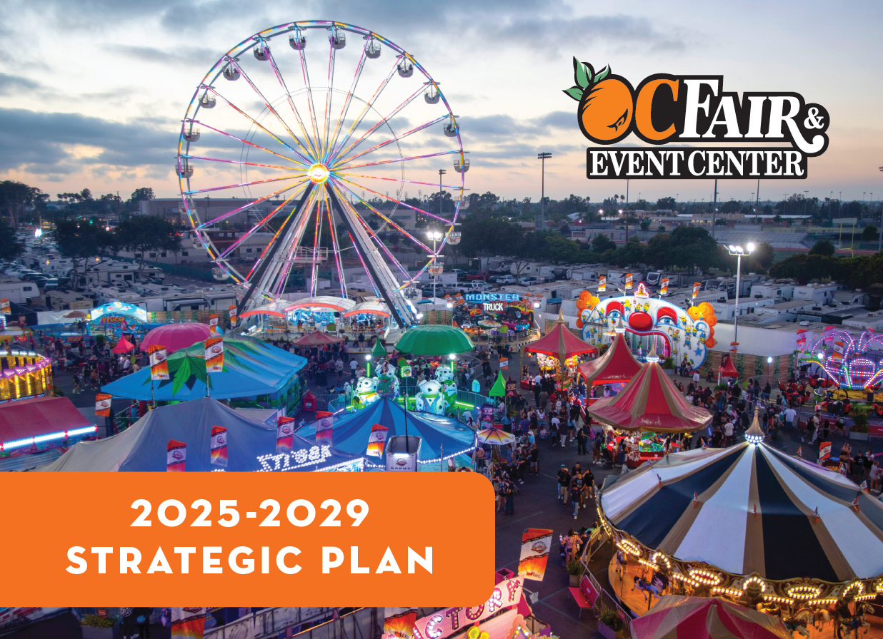
9. CEO’s Operational Announcements & Updates
OC City Managers
OC Supervisors
Costa Mesa city officials
Orange Coast College
Newport Mesa School District
OVG
RCS
OC Wine Society
Heroes Hall Veterans Foundation
Centennial Farm Foundation
Costa Mesa Chamber of Commerce
Travel Costa Mesa
CA Department of Food & Agriculture
OC Sheriff’s Department
Notes:
After the Board’s approval of the 2025-2029 Strategic Plan, we posted the plan on our ocfair.com web site. In addition, I sent an email to our contacts at the organizations listed on the slide with a link to the strategic plan.
There are six initiatives included in the plan. I assigned an executive champion to each initiative who will form employee task forces to work on each initiative. Every employee will have an opportunity to contribute and staff will provide updates each month to the Board as we work to achieve the goals approved by the Board.

Slide 11
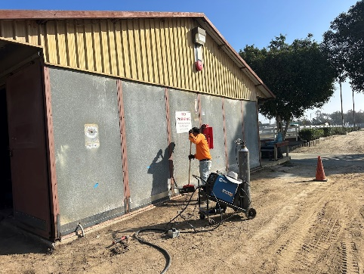
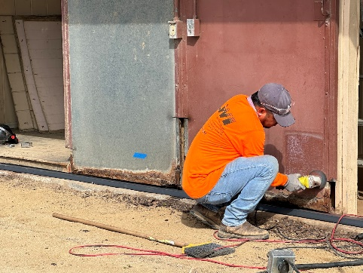
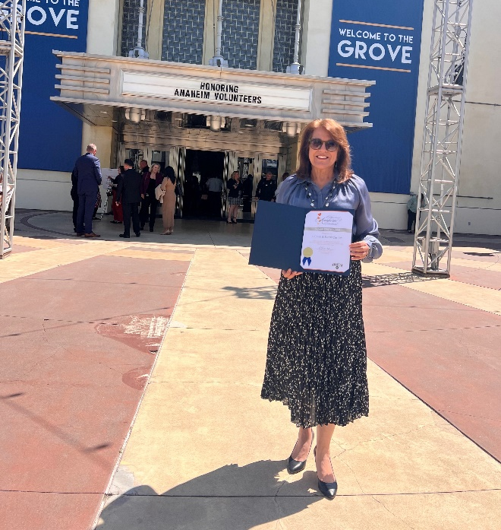
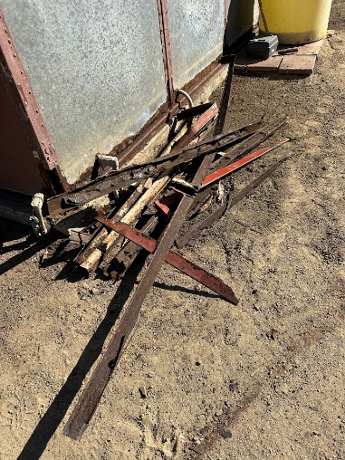
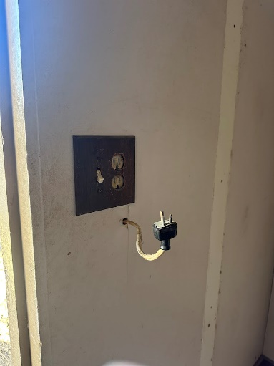
9. CEO’s Operational Announcements & Updates
Notes:
Each year the Anaheim Community Foundation on behalf of the City of Anaheim honors its volunteers and volunteer programs. OCFEC was honored this year with a Silver Award for our contributions to the Anaheim Public Libraries Summer Reading Program. Through fair admission ticket donations by Director Rubalcava-Garcia, Anaheim Public Libraries received hundreds of admission tickets to the 2022, 2023 and 2024 OC Fairs to use as prizes for kids participating in the summer reading program.
A new contract for horse stall cleaning, horse feeding and general facility maintenance went into effect April 1 and the crew from LWI has been busy repairing the stalls, starting with those on the east side designated for boarding of privately owned horses. You can see some of the work already started to clean-up the facility and address some code issues found in some of the stalls, offices and tack rooms.

Slide 12
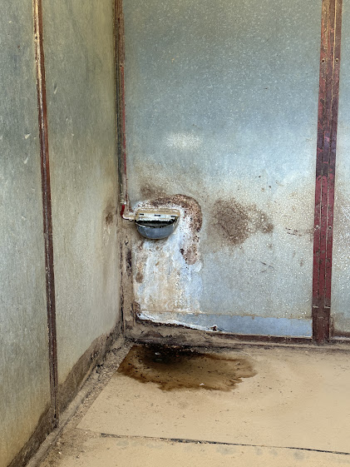
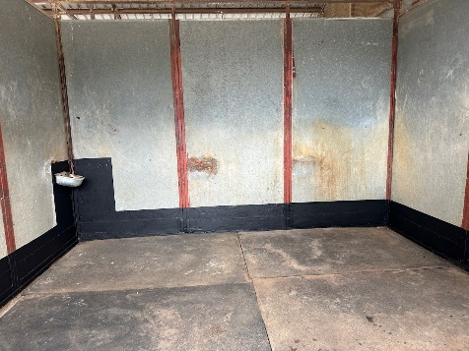
9. CEO’s Operational Announcements & Updates
Notes:
This is an example of some of the work in individual stalls. The photo on the left shows significant water damage and rust. After the crew addressed the rust around the base and fixed the water bowl, the stall is now ready for a new renter.

Slide 13
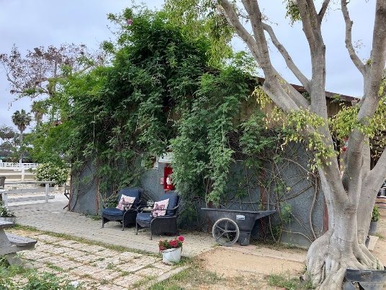
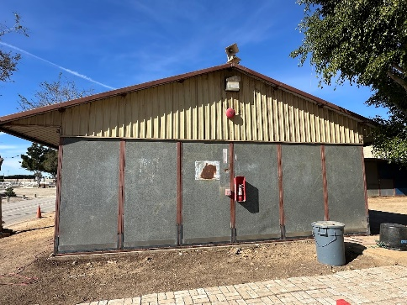
9. CEO’s Operational Announcements & Updates
Notes:
The end of this barn was filled with an overgrown vine that was damaging the structure and providing a nice hiding spot for critters. In addition, the patio area installed by a former renter was uneven and presented a potential trip hazard. The area has been cleaned up and leveled by the crew.

Slide 14
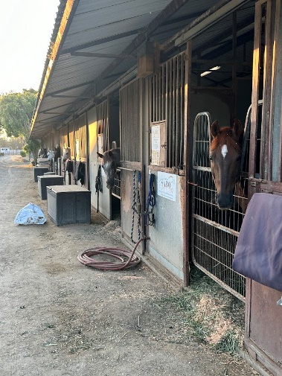
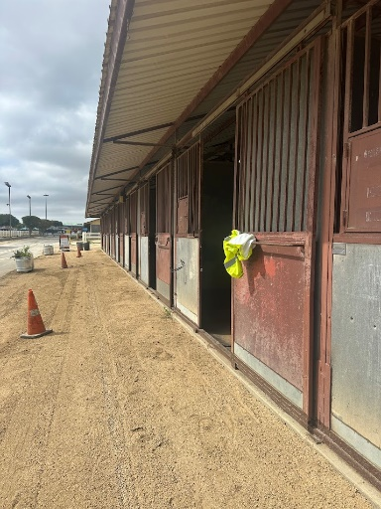
9. CEO’s Operational Announcements & Updates
Notes:
Barn aisles have been leveled to create smoother walkways free of ruts and trip hazards.
We’re looking forward to showing off the improvements and available stalls for rental at the May 14 Discovery Day. Staff continues to work to promote private rental opportunities on the east side of the property while rolling out the public education programs.

Slide 15

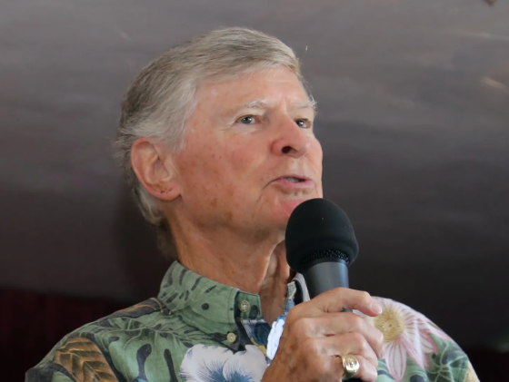

9. CEO’s Operational Announcements & Updates
85
In Memory of Ed Arnold
Notes:
85 days until fair – May we’ll share a few plans just to get you all excited, then full presentation in June.
It is with sadness that we announce the passing of Ed Arnold. Ed spent most of his career in television broadcasting in the Los Angeles market, but we knew him as an ardent supporter of veterans, Heroes Hall and the community. He did a tremendous amount of work to help us relocate the A-4M Skyhawk jet to Heroes Hall and served as emcee at many Heroes Hall programs. He will be greatly missed. Rest in peace, Ed.
And lastly, at our all-employee meeting on Tuesday, we recognized Earth Day. I read a statement from California Secretary of Food & Agriculture, Karen Ross. It’s a good reminder of our purpose as a fairgrounds and our connection with agriculture.
In recognition of Earth Day, CDFA would like to lift-up farmers and ranchers as stewards of the land, nurturing the soil, conserving water, and protecting biodiversity to sustain our food systems.
In California, where 90 percent of farms are family-owned, these growers provide a third of the nation’s vegetables and over three-quarters of its fruits and nuts—all while navigating challenges like drought, extreme heat, and shifting pest pressures.
CDFA is committed to supporting a vibrant agricultural economy, healthy communities, and thriving ecosystems.
This Earth Day let’s celebrate the hardworking hands that feed us while protecting our natural resources—because for farmers and ranchers, every day is Earth Day!

Slide 16
10B. Review Past Due Amounts and Vote on Whether or Not to Write-Off
California Government Code Section 13943.2 [Renumbered as 12438, effective June 27, 2016] authorizes the Board of Directors to discharge uncollectible accounts of five hundred dollars ($500) or less once a debt is considered uncollectible.
Pursuant to the California Department of Food and Agriculture, Division of Fairs and Expositions Accounting Procedures Manual, Section 2.453, staff is requesting approval to write-off the following debts:

Slide 17
Name | Event | Due Date | Invoice No. | Amount
Armando Cardenas | 2022 Junior Livestock Auction | 7/31/2022 | 12325 | $ 56.75
Conrad Macalalad | 2022 Junior Livestock Auction | 7/31/2022 | 12333 | $ 22.70
Jennifer [No last name provided] | 2022 Junior Livestock Auction | 7/31/2022 | 12328 | $ 39.77
Michelle Wiley | 2022 Junior Livestock Auction | 7/31/2022 | 12322 | $ 28.42
Noa Mashhad | 2022 Junior Livestock Auction | 7/31/2022 | 12332 | $ 22.70
Roger Zarate | 2022 Junior Livestock Auction | 7/31/2022 | 12321 | $ 212.64
Frank Cittadino | Equestrian center feed & late fee | 1/23/2023 | 12578 | $ 229.00
Margie Sullivan | Equestrian center boarding | 6/1/2024 | 14366 | $ 0.01
Jacmar Foodservice Distribution | 2019 Group sales for OC Fair | 8/23/2019 | 10718 | $ 405.00
Legacy Fighting Alliance, LLC | R-058-20 Event Rental | 2/12/2020 | 11006 | $ 237.00
Jurassic Quest Holdings, LLC | R-026-24 Event Rental | 11/7/2023 | 13713 | $ 0.01
Roy Englebrecht Promotions | R-056-21 Event Rental | 12/2/2021 | n/a | $ 286.00
Specialty Coffee Association | R-001-20 Event Rental | 3/2/2020 | 11044 | $ 176.12
Union of the Vietnamese Student Association | R-004-23 Event Rental | 2/8/2023 | 12644 | $ 0.02

Slide 18
10B. Review Past Due Amounts and Vote on Whether or Not to Write-Off
It should be noted that outstanding payments incur a late fee of 1.5% per month. Where applicable, staff is requesting approval to also write-off the late fees associated with the above-noted debts.
The Finance Department has made numerous attempts to collect on these items without success.
In addition, staff is requesting that moving forward the Board of Directors delegate approval to staff to automatically write-off debt of $0.99 or less.
RECOMMENDATION:
Staff is recommending approval to write-off all past due amounts listed in this report, along with approval for staff to automatically write-off any debt of $0.99 or less in the future.
Notes:
190 of the 447 were outside Orange County

Slide 19
10C. Annual Consideration and Vote on the Number of Discounted Fair Admission Tickets and Parking Passes to Allocate to Centennial Farm Foundation Board Members
According to the MOU between the 32nd District Agricultural Association and the Centennial Farm Foundation, the “District, at its sole discretion, may provide to each active Foundation Board member one (1) complimentary pass to District’s annual county fair, which pass may include an F Lot parking hang tag. The type and quantity of additional complimentary passes will be assessed by the District on an annual basis.”
Notes:
Mathew – Design & Décor Supervisor

Slide 20
10C. Annual Consideration and Vote on the Number of Discounted Fair Admission Tickets and Parking Passes to Allocate to Centennial Farm Foundation Board Members
In 2024, the Board of Directors voted to provide one F-Lot parking pass and one complimentary pass for each day of the 2024 OC Fair to each active Centennial Farm Foundation Board member. In addition, the Board approved the ability for each active Centennial Farm Foundation Board member to purchase up to ten (10) general admission fair passes at a cost of $2 each.
RECOMMENDATION:
Staff recommends approval of the same ticket allotment for each active Centennial Farm Foundation Board member as in 2024.
Notes:
Mathew – Design & Décor Supervisor

Slide 21
10D. Staff Recap of Imaginology 2025
INFROMATION ITEM:
Staff will present a recap of 2025 Imaginology event which was held April 12-13. With free admission, Imaginology attracts thousands of kids, parents and families, and is the District’s biggest community give-back of the year.
Notes:
190 of the 447 were outside Orange County

Slide 22

FREE Admission
10:00 am – 4:00 pm
Notes:
Zany Zoe’s Magic Show: https://www.zanyzoe.com/
Megan the Bubbleologist: https://www.bubbleologist.com/
Mind Works

Slide 23

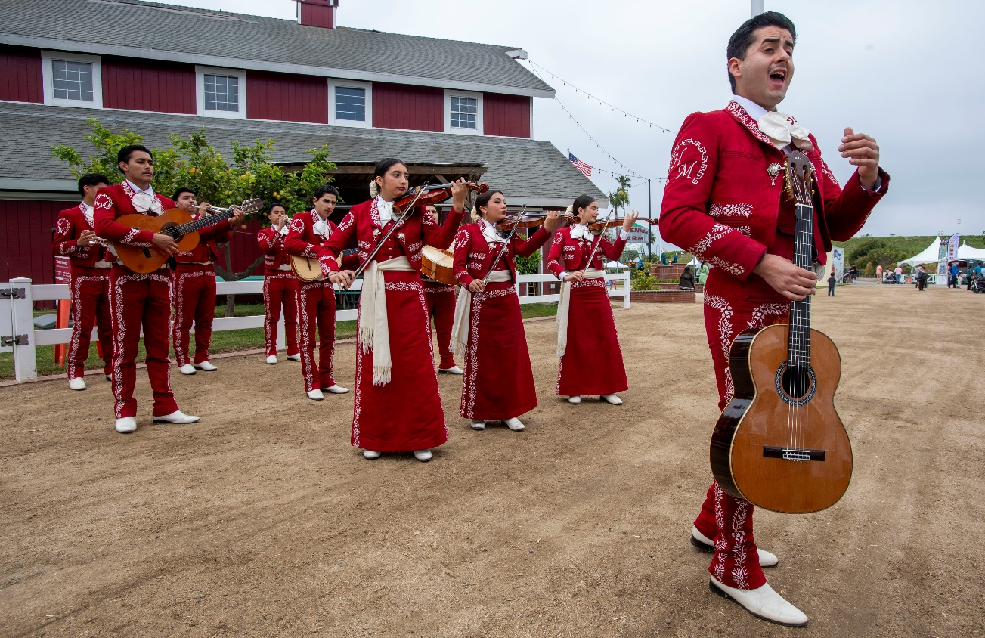


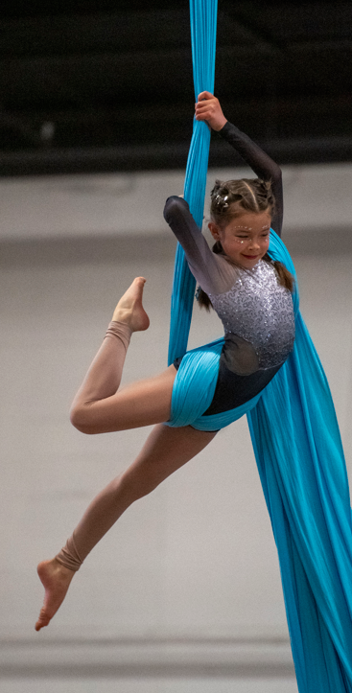
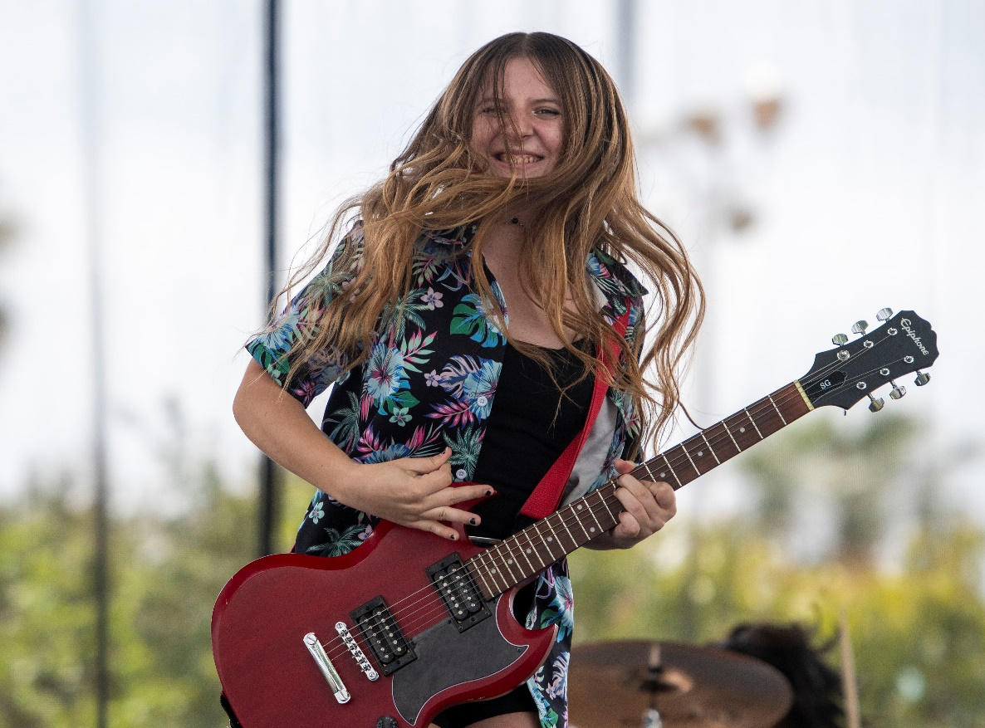
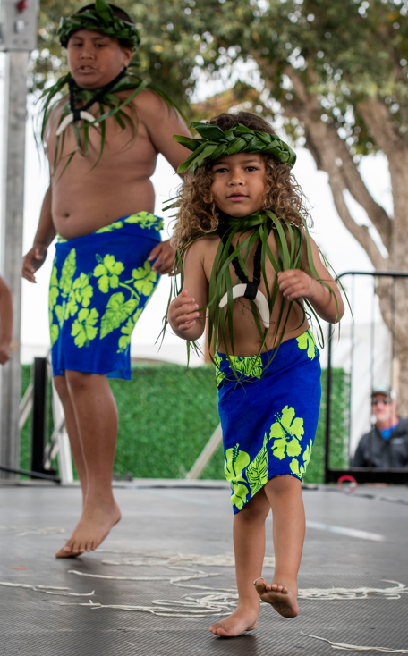
Community Talent

Slide 24
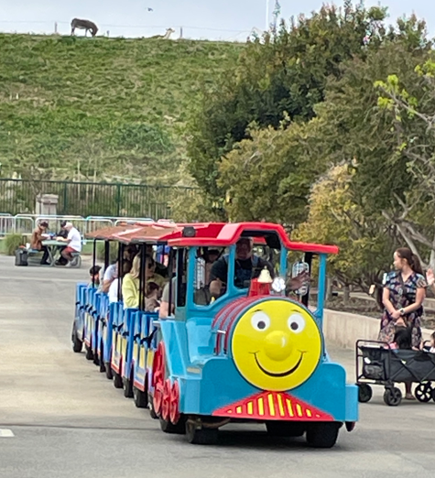
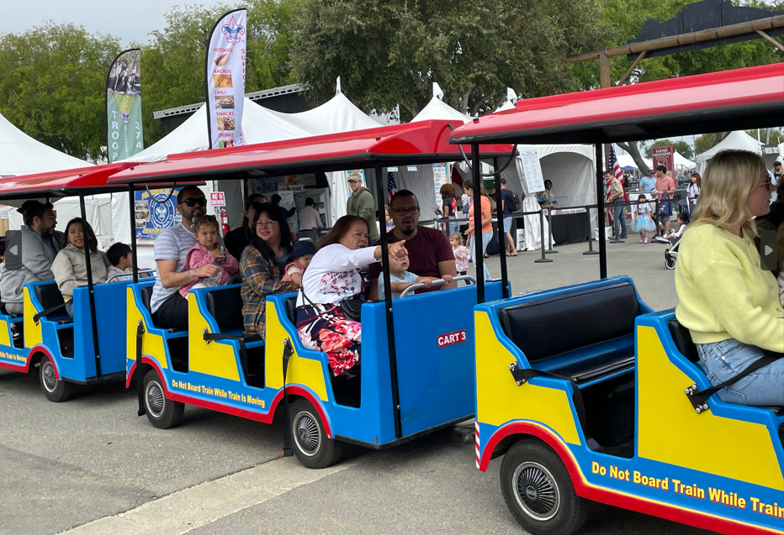
Roaming Railroad
New for 2025
Notes:
We’ve got a few new things this year to add to the excitement. A mini steam train will be on hand this year offering rides for a nominal fee

Slide 25

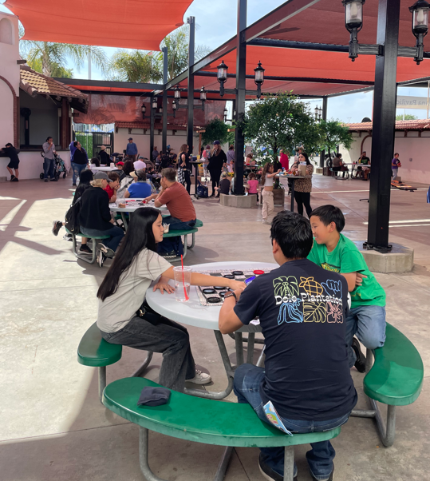
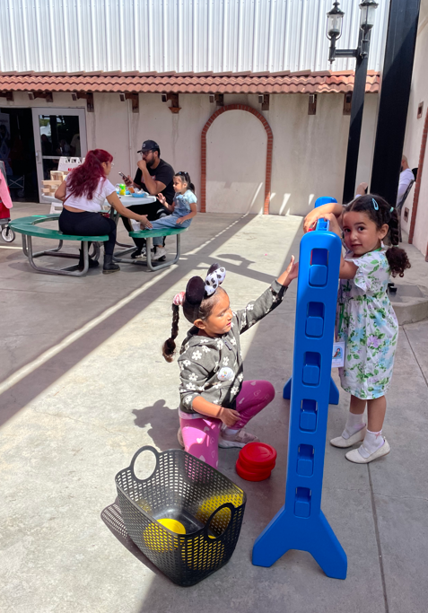
Timeout Lounge
New for 2025
Notes:
The games and refreshments provided exactly the atmosphere we were looking for. Just a nice space to take a break and reset.

Slide 26
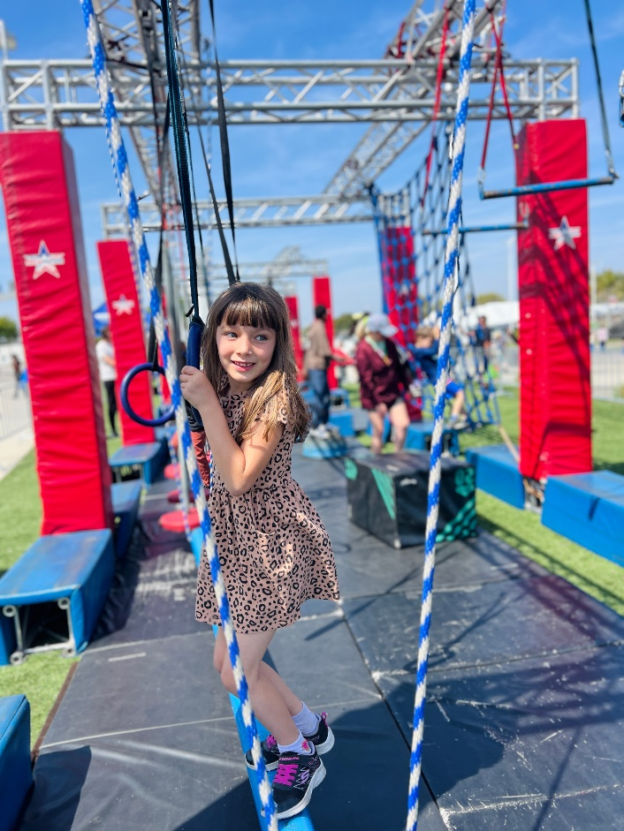
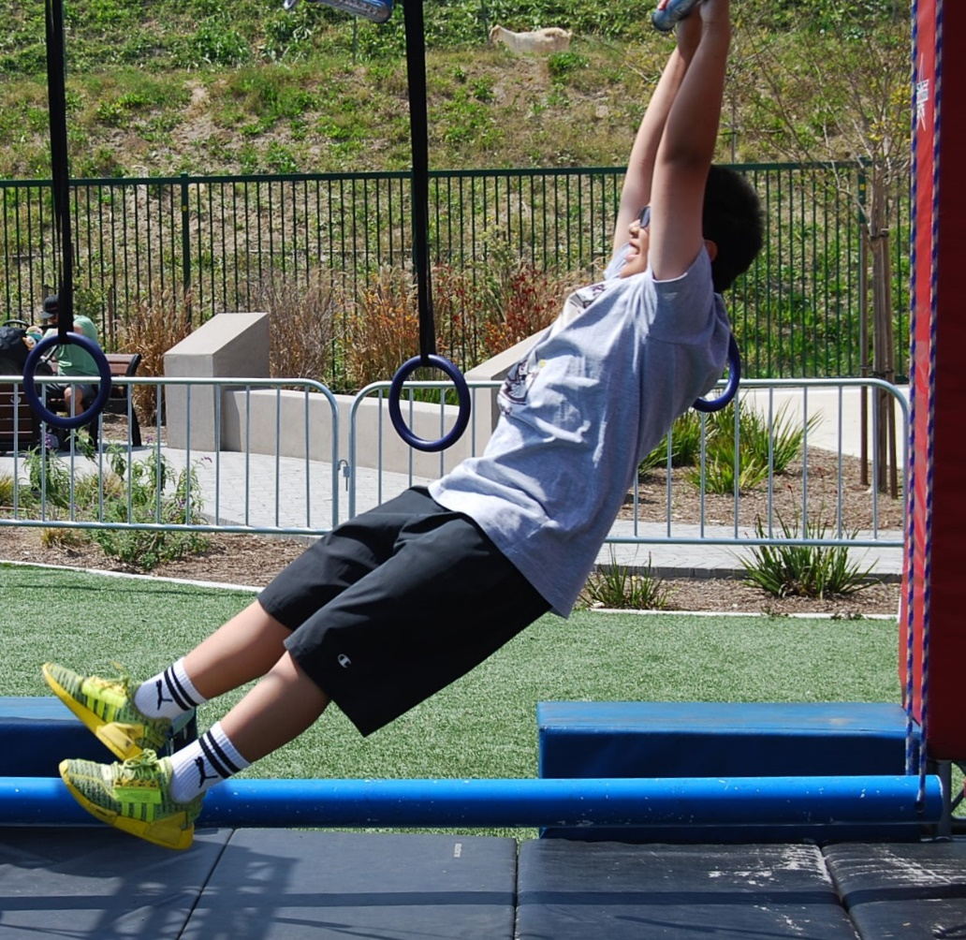
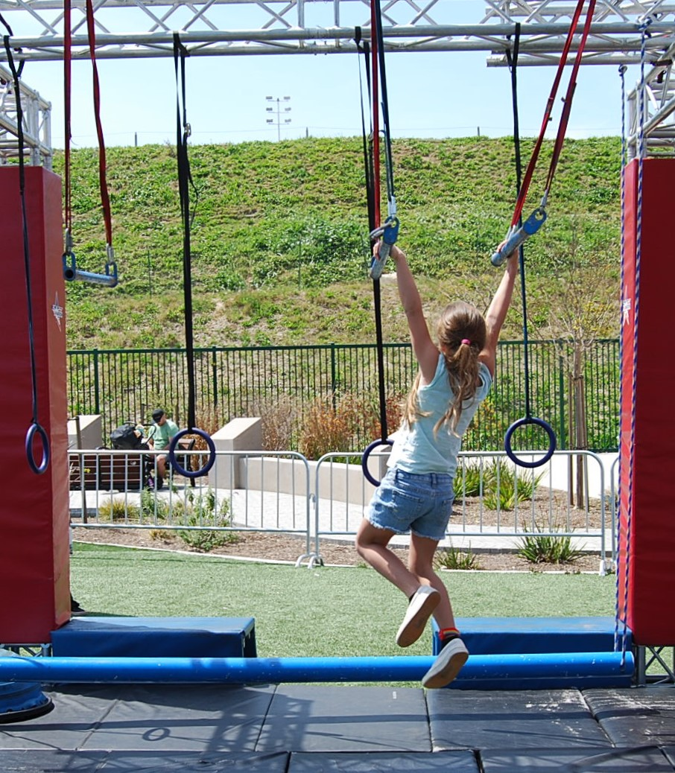
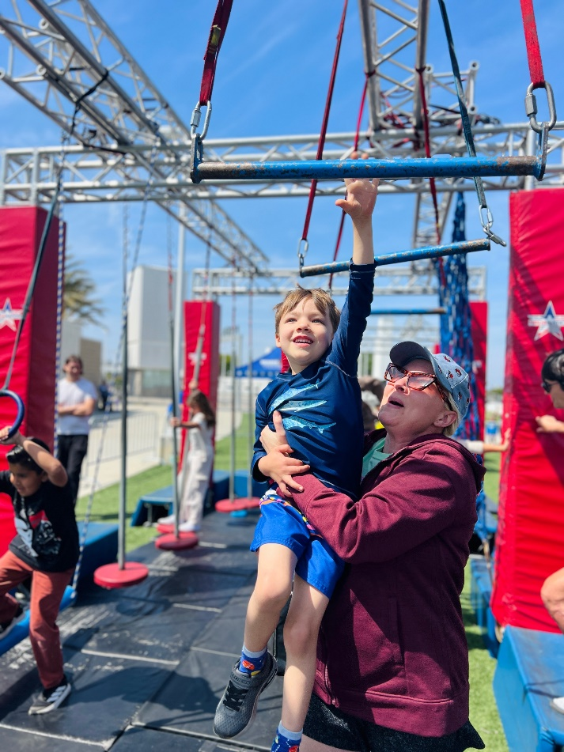
Ninja Nation Boot Camp
New for 2025
Notes:
We’re very excited about the addition of the Ninja Nation Boot Camp.

Slide 27


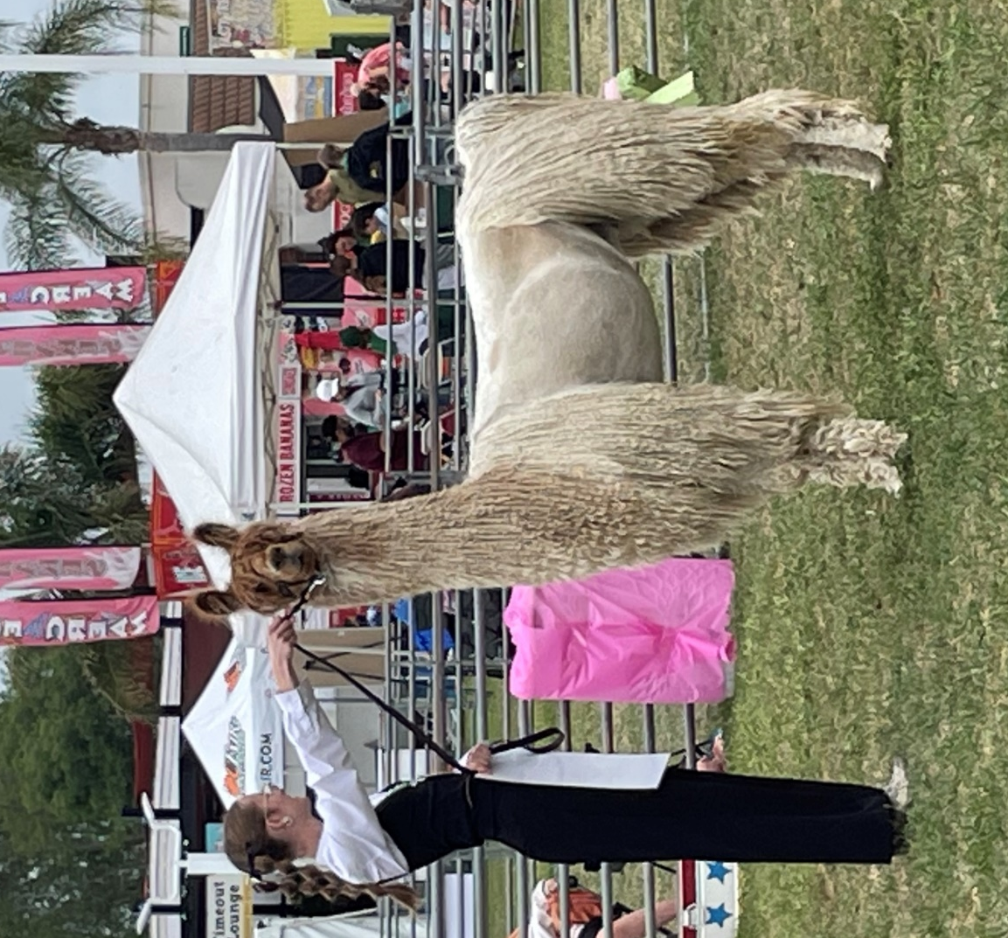
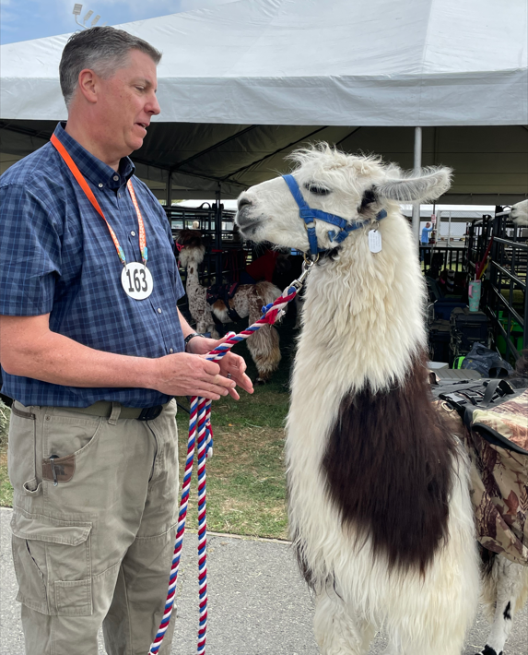
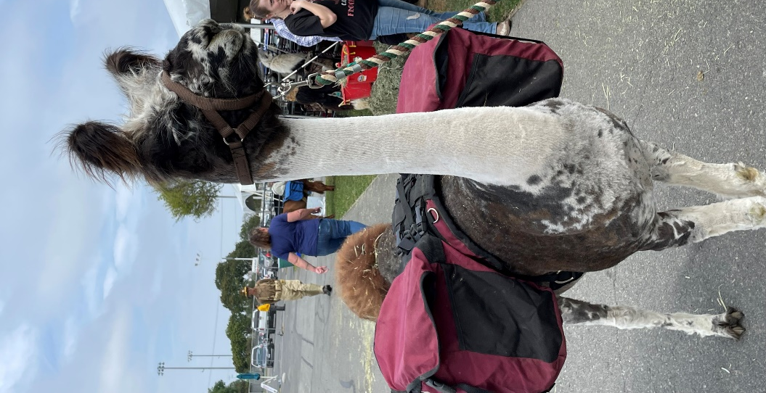
Llama Competition
New for 2025
Notes:
So many llamas.

Slide 28
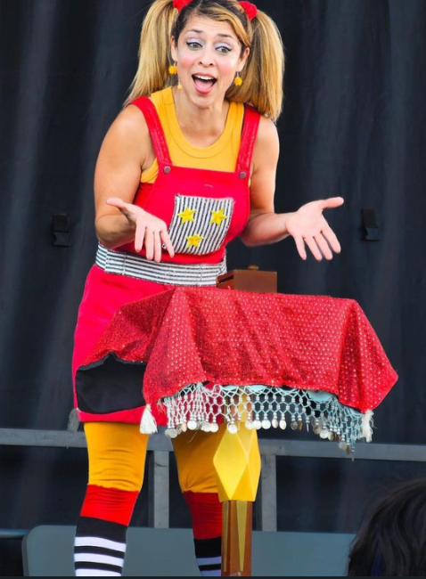
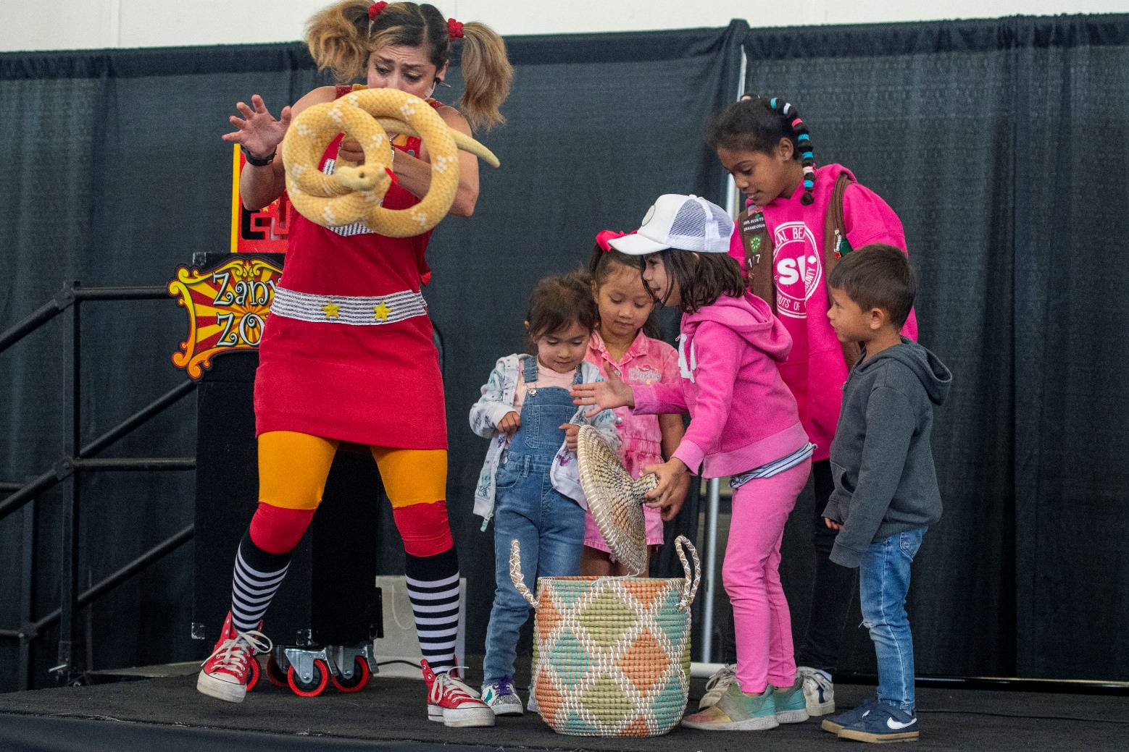
Zany Zoe’s Comedy Magic Show
New for 2025
Notes:
Zoe totally entertained the crowds, both with her roaming act and on-stage in the Santa Ana Pavilion. She is a high-energy, family-friendly with amazing tricks, audience interaction, and nonstop fun!

Slide 29
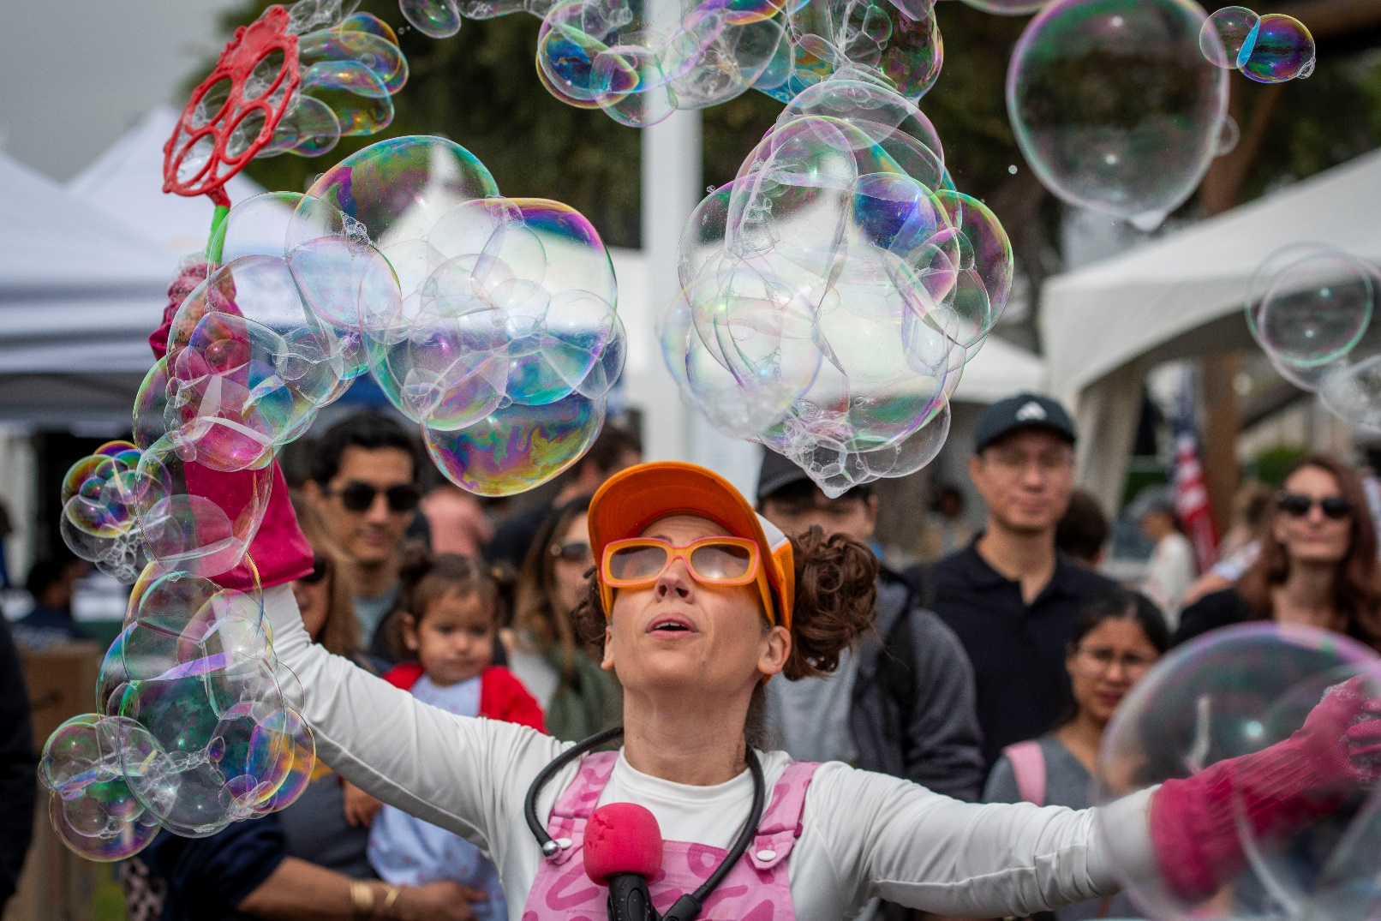
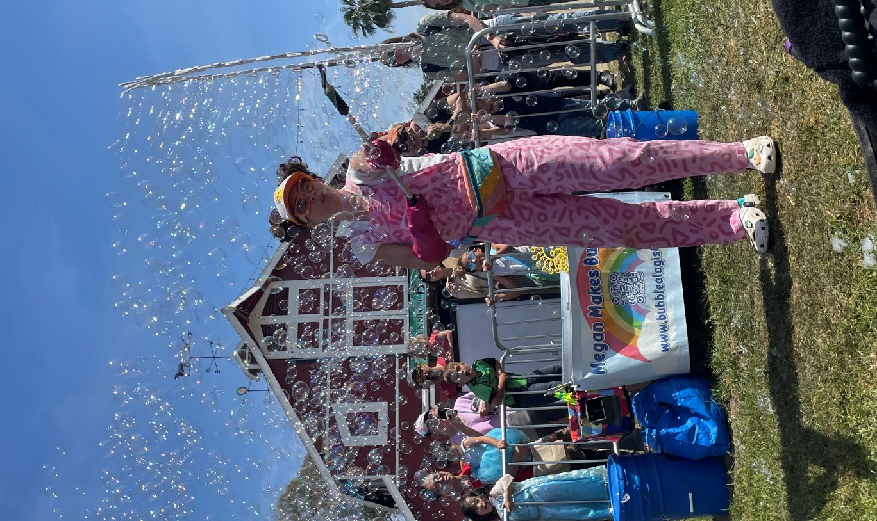
Bubbleologist
New for 2025
Notes:
Megan the Bubble-ologist. She had several performance each day and kept the crowds entertained.

Slide 30
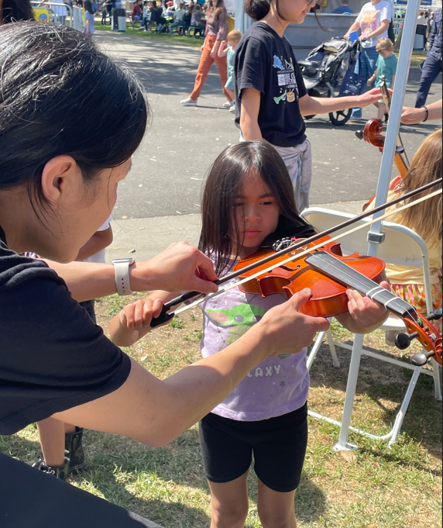
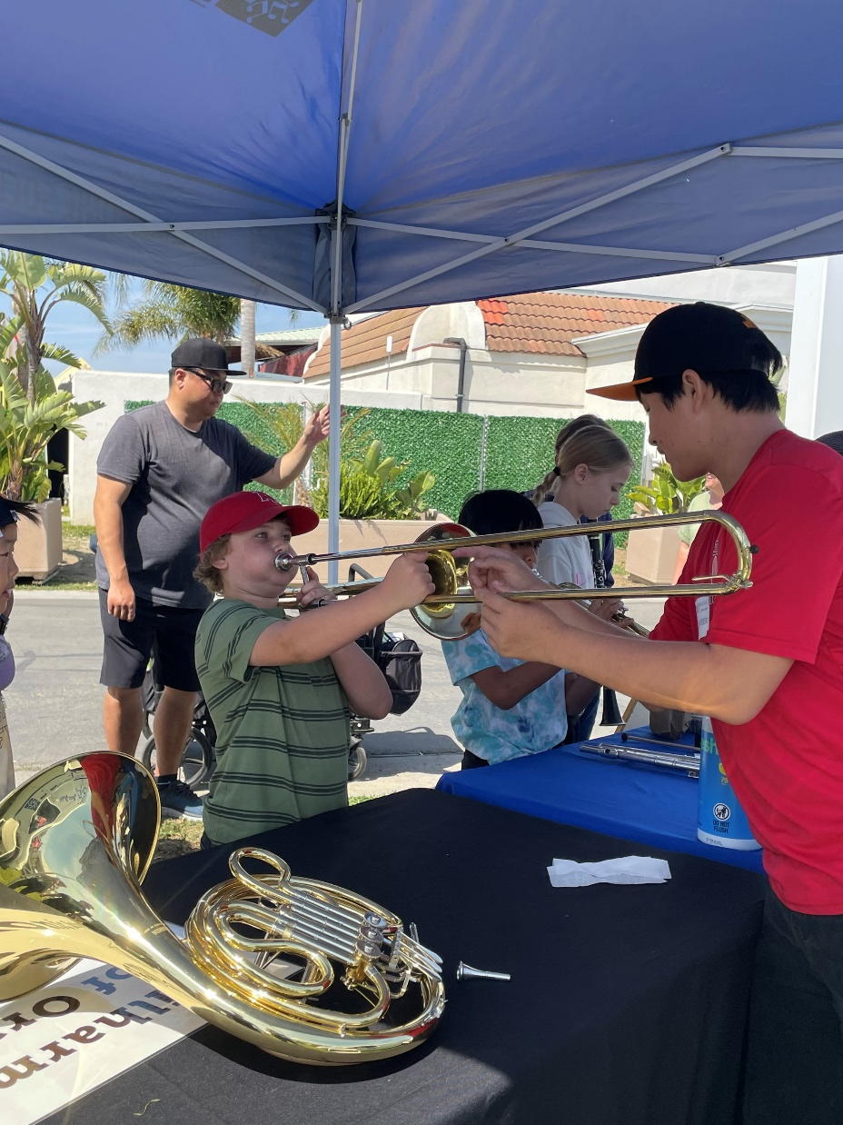
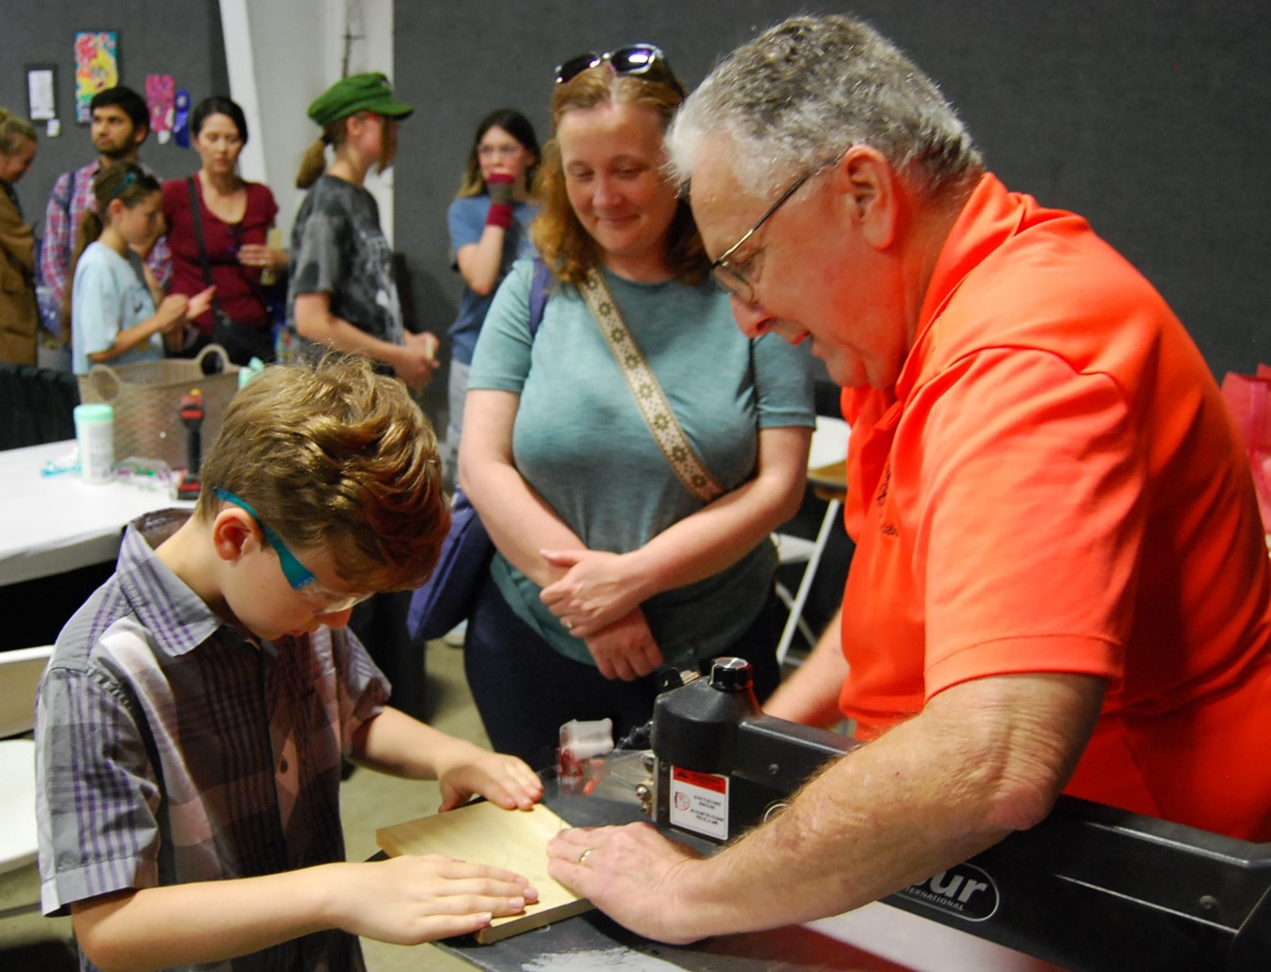
Hands-On Experiences
Notes:
Hundreds of hands on experiences for kids to test their skills and learn.

Slide 31
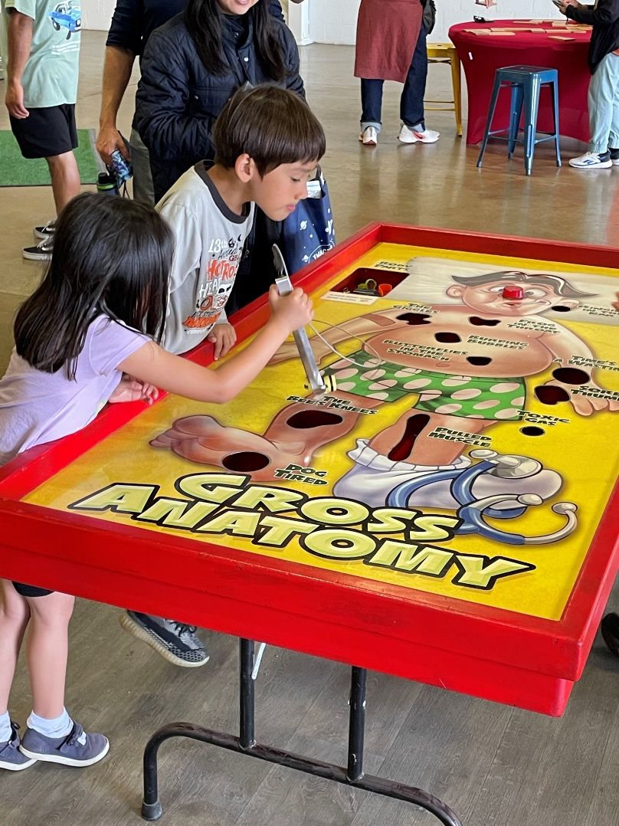
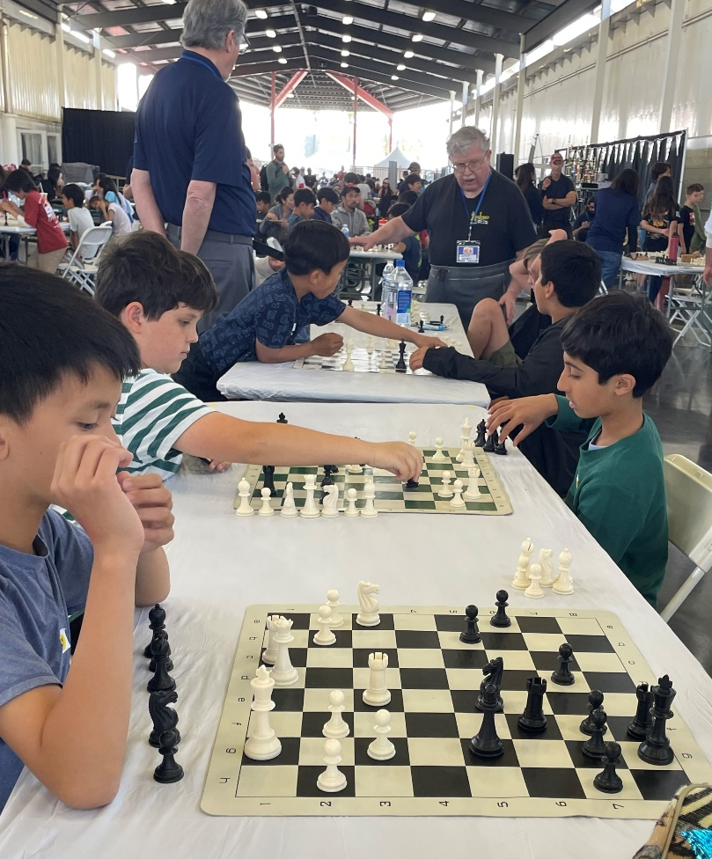
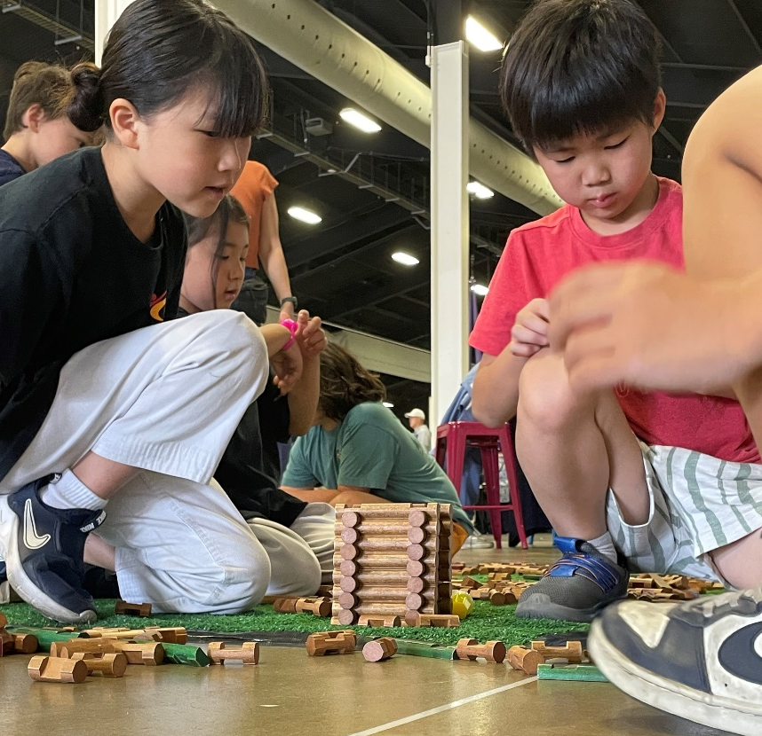
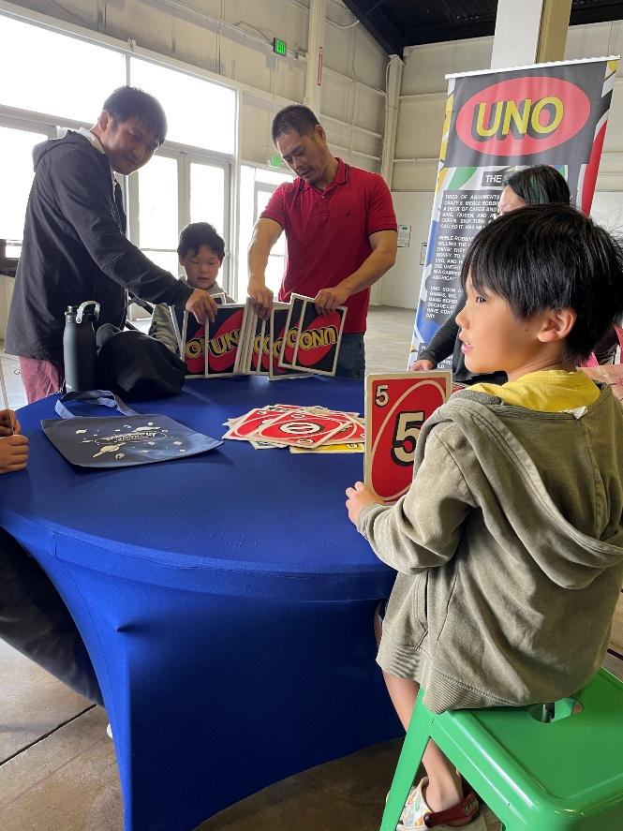
Games
Notes:
Not new to Imaginology, but returning, the very serious Academic Chess- Tournament of Champions AND the new Mind Works Game room featuring the game board and toy classics

Slide 32
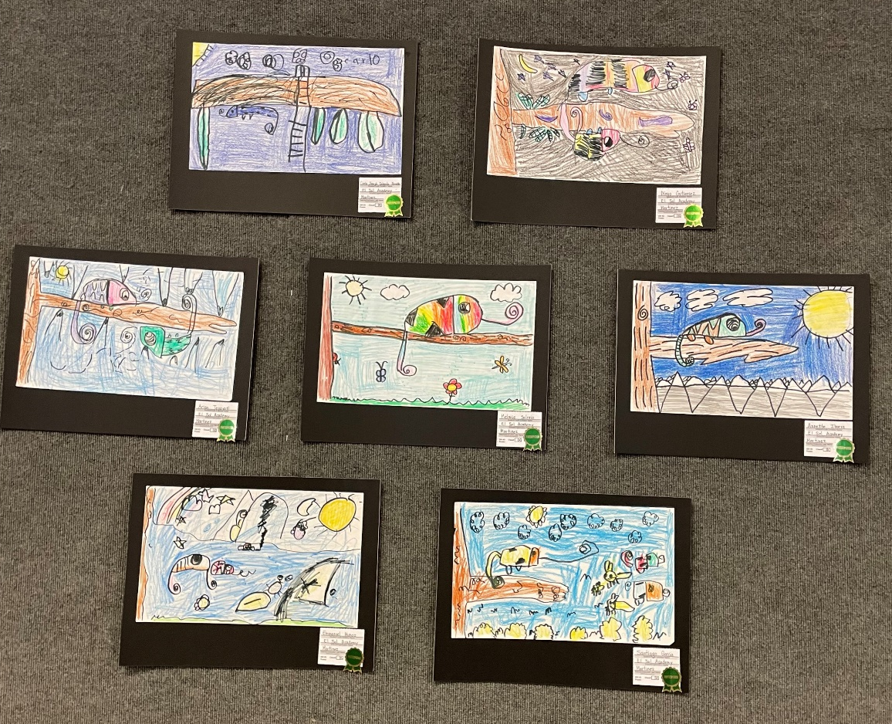
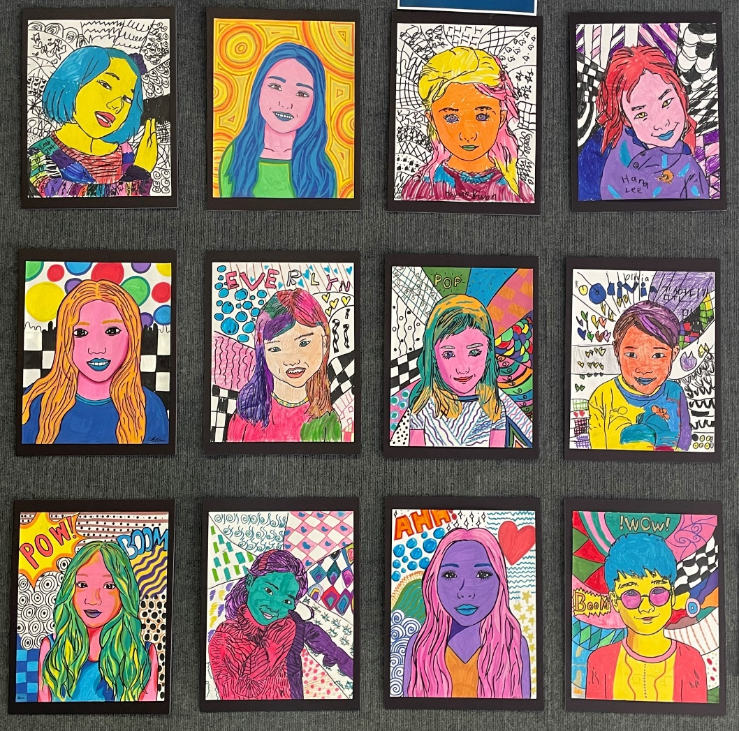
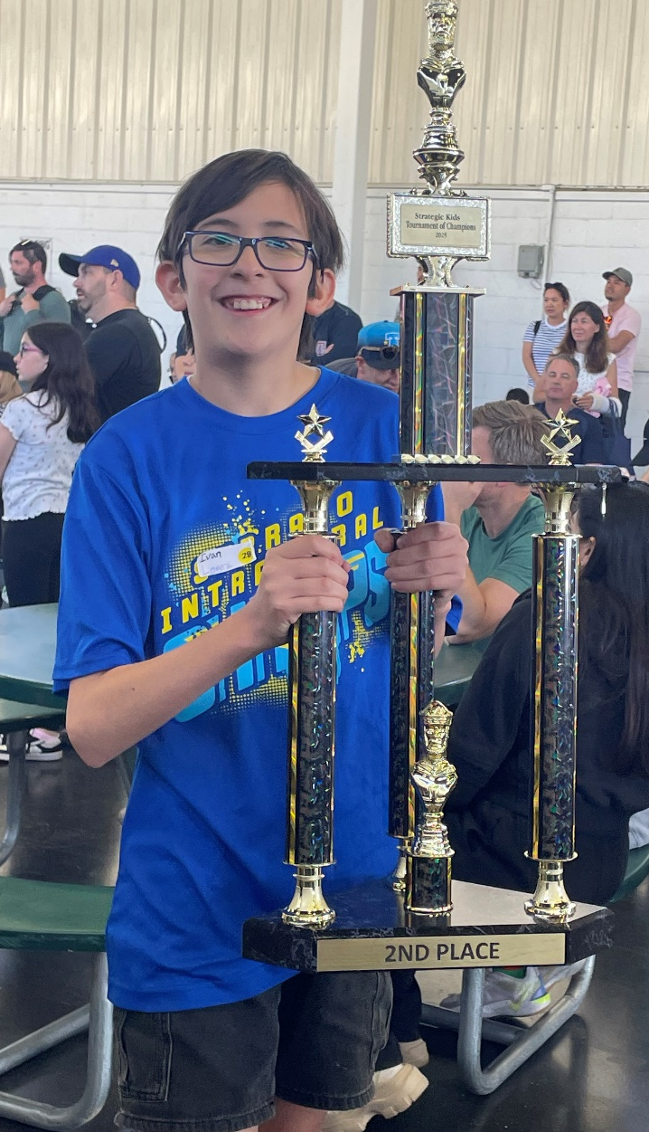
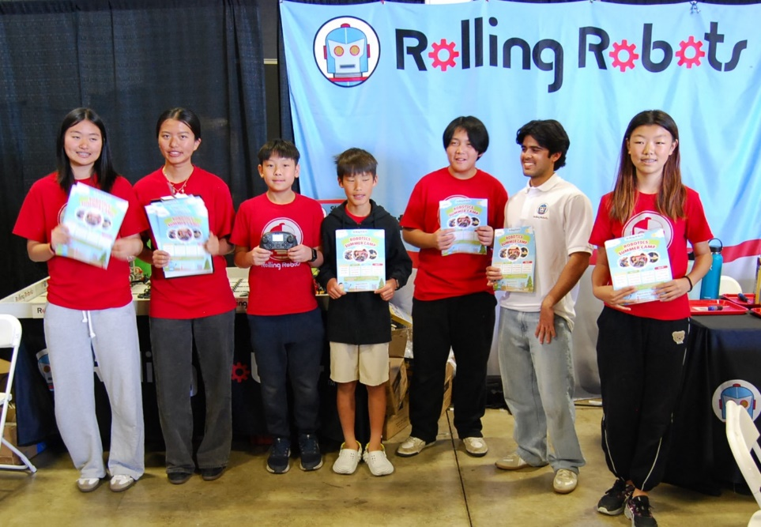
Imaginology Competitions
Live Community Entertainment
Notes:
And new competitive art entries will be on display as schools from around the county have spent the last month working on various projects, murals, paintings, and cardboard sculptures.

Slide 33
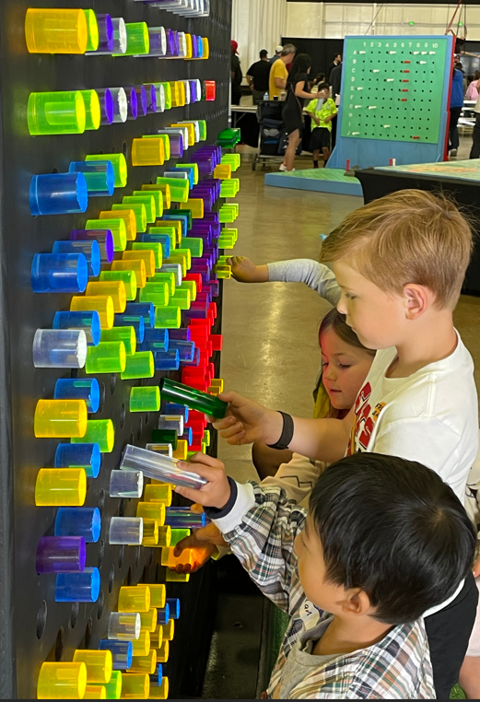
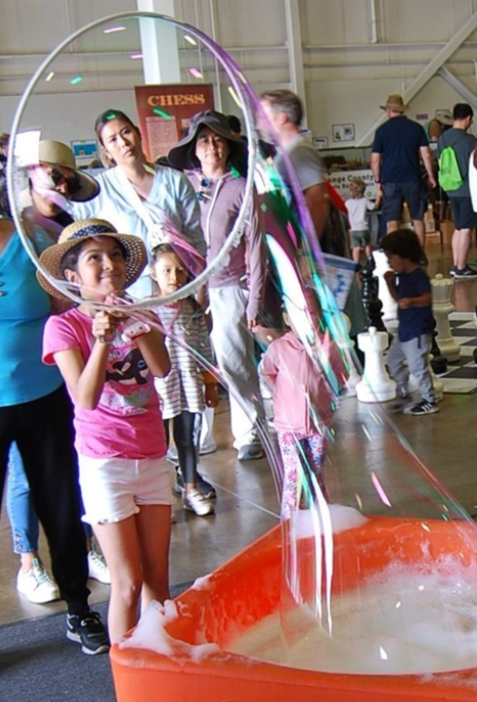
What do you get when you add
Hands-on fun + captivating STEAM
displays & activities?
Notes:
If you’ve been you know! If you haven’t, you must go! It’s an unbelievable Fun Filled Day of Learning for Everyone.

Slide 34
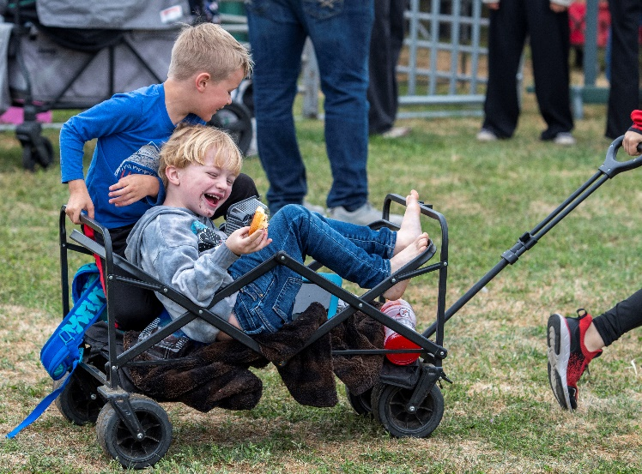
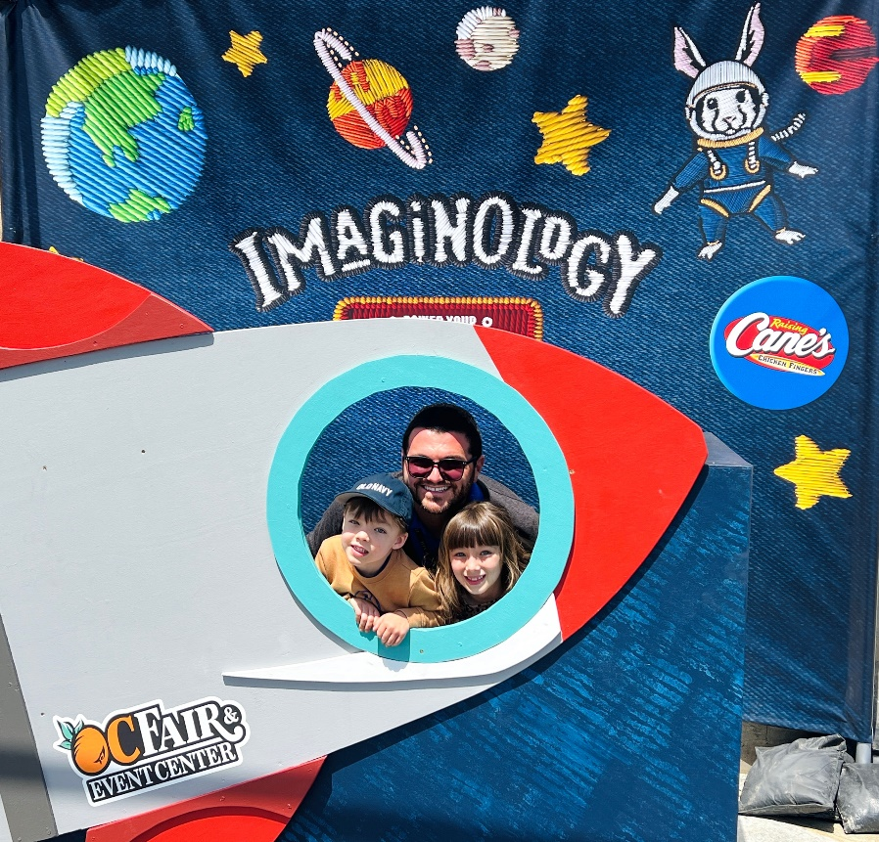
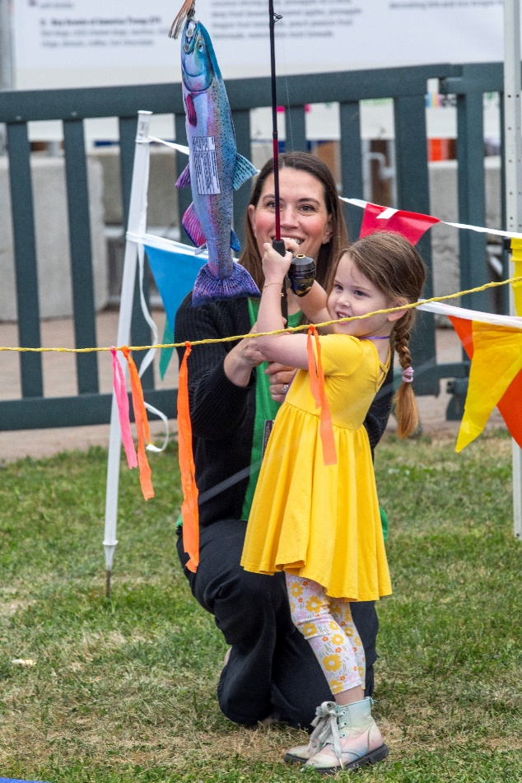






Notes:
If you’ve been you know! If you haven’t, you must go! It’s an unbelievable Fun Filled Day of Learning for Everyone.

Slide 35



Congratulations
Corral Family!
Notes:
We chose our winner of the Grand Prize Giveaway and we know they’ll have the best year ahead with all the activities included in the prize package! Congrats to the Corral Fam!

Slide 36
10E. Committee/Ad Hoc Committee/Liaison Reports
INFORMATION ITEM:
To assure compliance with the Bagley-Keene Open Meeting Act, Committee reports are only for the purpose of the Committee chair, Ad Hoc Committee members or Liaison to provide a verbal update. Should the Board want to discuss any Committee work item not already on the agenda; those would need to be agendized for a future Board meeting.
Leadership Committee (Chair Kovacevich, Committee Chair; Vice Chair Bagneris)
Financial Monitoring and Audit Committee (Director Pham, Committee Chair; Director Bilezikjian)
Facilities Committee (Director Ruiz, Committee Chair; Director Bilezikjian)
Governance Committee (Director La Belle, Committee Chair; Chair Kovacevich)
Community Affairs Committee (Director Rubalcava-Garcia, Committee Chair; Director Jackson)

Slide 37
March 2025 Financials
 | Actual | Budget | Variance Favorable (Unfavorable)
March 2025 Revenue | $ 1,387,302 | $ 1,551,243 | ($ 163,941)
March 2025 Expenses | $ 2,331,507 | $ 2,861,997 | $ 530,491
March 2025 Net Proceeds/(Loss) | ($ 944,205) | ($ 1,310,754) | $ 366,550

Slide 38
Cash and Cash Equivalents
 | March 31, 2025 |  | March 31, 2024
Cash on Hand | $ 4,891,656 |  | $ 1,955,674
Investments | $46,632,305 |  | $44,617,193
Total Cash and Cash Equivalents | $51,523,960 |  | $46,572,867
Year over Year Change | $ 4,951,093
Year over Year % Change | 10.63%

Slide 39
10E. Committee/Ad Hoc Committee/Liaison Reports
INFORMATION ITEM:
To assure compliance with the Bagley-Keene Open Meeting Act, Committee reports are only for the purpose of the Committee chair, Ad Hoc Committee members or Liaison to provide a verbal update. Should the Board want to discuss any Committee work item not already on the agenda; those would need to be agendized for a future Board meeting.
Leadership Committee (Chair Kovacevich, Committee Chair; Vice Chair Bagneris)
Financial Monitoring and Audit Committee (Director Pham, Committee Chair; Director Bilezikjian)
Facilities Committee (Director Ruiz, Committee Chair; Director Bilezikjian)
Governance Committee (Director La Belle, Committee Chair; Chair Kovacevich)
Community Affairs Committee (Director Rubalcava-Garcia, Committee Chair; Director Jackson)

Slide 40



Slide 41


Slide 42


Slide 43


Slide 44


Slide 45


Slide 46



Upcoming Events Preview
APR 26
MAY 2 - 4
MAY 9 - 11
MAY 10
MAY 14
MAY 17
Notes:
AIR & WATER From 9 – 3 on Saturday. the ultimate Porsche celebration roars back to the heart of Southern California. From vintage legends to modern heroes, experience the legacy, embrace the future and become part of a community that knows no equal.
OC Marathon Weekend is May 2-4 beginning Friday May 2 from 3-7pm with a fitness Expo. Runners can pick up their packets and checkout 75 Fitness and Fun brands in the expo.
Then Saturday is the final mile of the Kids Run. The expo is opn to the public between 10am & 5pm. The party really kicks off from 2 -7 with bands, and OC Sports teams.
Sunday is the real deal – the full and half marathons begin with cars being left onsite before the sun even rises and then the runners are bussed to the start line at Fashion Island. They’ll run through the streets of Newport and Costa Mesa culminating with a Finish Line Party here at Fair Drive!
The Gem Faire is back again May 9 – 11 and
Speedway is back on Sat. May 10 & 17
And on the 14th maybe you’ll feel a little Wild & Crazy like the 32nd Annual All you can eat Taco Night supporting Share Ourselves’ mission of providing accessible health and social services to those in need. Check out the fundraiser information on the website.

Slide 47


11. Upcoming Events Preview
Thursdays
Notes:
Don’t forget to bring your household donations on Thursdays, side by side with the Farmers Market, Goodwill is here with their big donation truck

Slide 48


11. Upcoming Events Preview
Classes at Centennial Farm
MAY 10
Sow and Grow! – Transplanting Seedlings into Your Garden
MAY 17
Make It, Take It: Food Preservation
Notes:
Saturday May 10– the Sow & Grow Class You’ve planted your seeds, Now What?!! This class teaches the basics of transplanting seedlings into a garden successfully with minimal stress to the plant and you.
Saturday, May 17 – Learn how to preserve – the cost includes ingredients, handouts and jars.

Slide 49







April 30, May 10 & 31
Discovery Days May 7, 15 & 19
Notes:
Discovery Days have been booked to capacity week after week! May 7, 15 & 19 are already filled.
Heroes Hall Speaker Series continues next Wednesday, April 30 from 6-8pm with “From Camp Pendleton to Vietnam: Married Marines Reflect on Flights of Terror to Rescuing Refugees.” This will be held in the Pacific Amphitheatre Lobby.
Then on Saturday, May 10- Breaking Their Silence: Filmmakers Capture Stories of Japanese American Vietnam Veterans ( from 2-3:30pm at Heroes Hall)
Continuing to Saturday, May 31 we have “Beyond the Battlefield: Navigating the Journey of Veterans with PTSD.” The presentation will include a screening of documentary film “The Volunteer,” followed by Q&A with the filmmaker and discussion on PTSD (from 2-4p at Heroes Hall)

Slide 50

11. Upcoming Events Preview
Notes:
We’re excited to share the inaugural Ranch Discovery Day on May 14 reservation list is at capacity! The day will be filled with animals including horses, chickens and rabbits. Children will explore horse care and grooming, military horses, arena grooming, the importance bees, horse demonstrations so much more. We hope all of you will join us for the morning.

Slide 51
12. Board of Directors Matters of Information
Next Board Meeting
May 22, 2025
Community Room at the City of Costa Mesa City Hall

